Slide 1
“
DISASTER ASSESSMENT
”
Milestone Presentation
Team Member: Yuan Chang, Jiachen Huang, Maaheen Yasin

Slide 2
CONTENTS
PART 01.
Background
PART 02.
Current Solutions & Challenges
PART 03.
Proposed Solution & Milestones

Slide 3
Background
PART 01.
What is the problem?
Why is this problem important/useful?

Slide 4

Question:
What are the most efficient methods for assessing disaster damages?

Slide 5
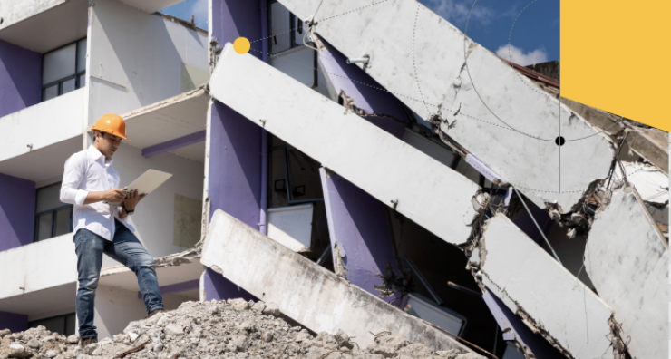
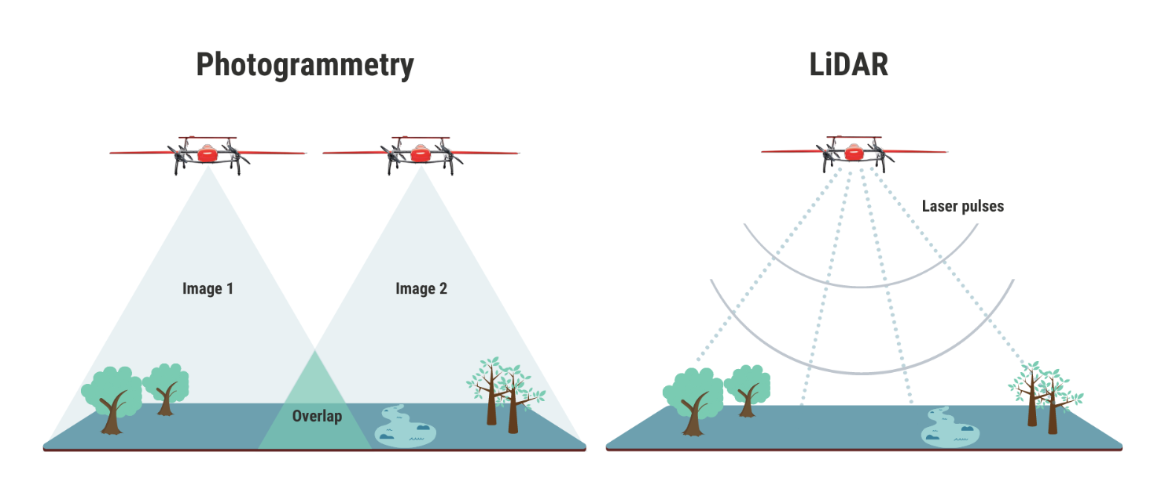
Background
Traditional methods:
Manual inspections
ground-based sensors

Slide 6
Drawbacks
Time-Consuming Process
Manual damage assessment of 200,000 buildings took months, delaying recovery. (Haiti Earthquake, 2010)
Limited Geographic Coverage​
Many areas were inaccessible to inspectors due to flooding and damage. (Hurricane Katrina, 2005)​
Subjectivity and Inconsistent Results
Varying evaluations between teams led to incorrect damage categorization in about 30% of cases, significantly impacted recovery planning and resource distribution. (Haiti Earthquake, 2010)
Slow Data Processing
Led to logistical challenges in distributing resources to the most affected areas. (Indian Ocean tsunami, 2004)

Slide 7
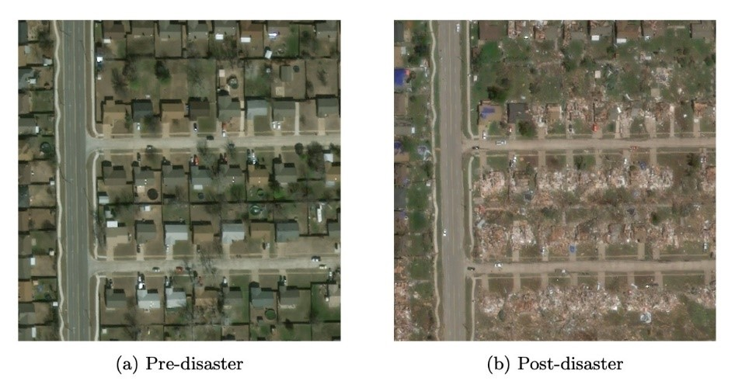
Satellite Imagery
Provides a powerful means to assess widespread disaster damage.
Example:
The xBD dataset

Slide 8
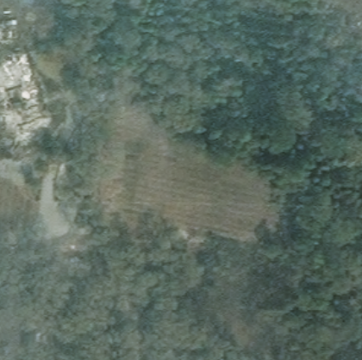
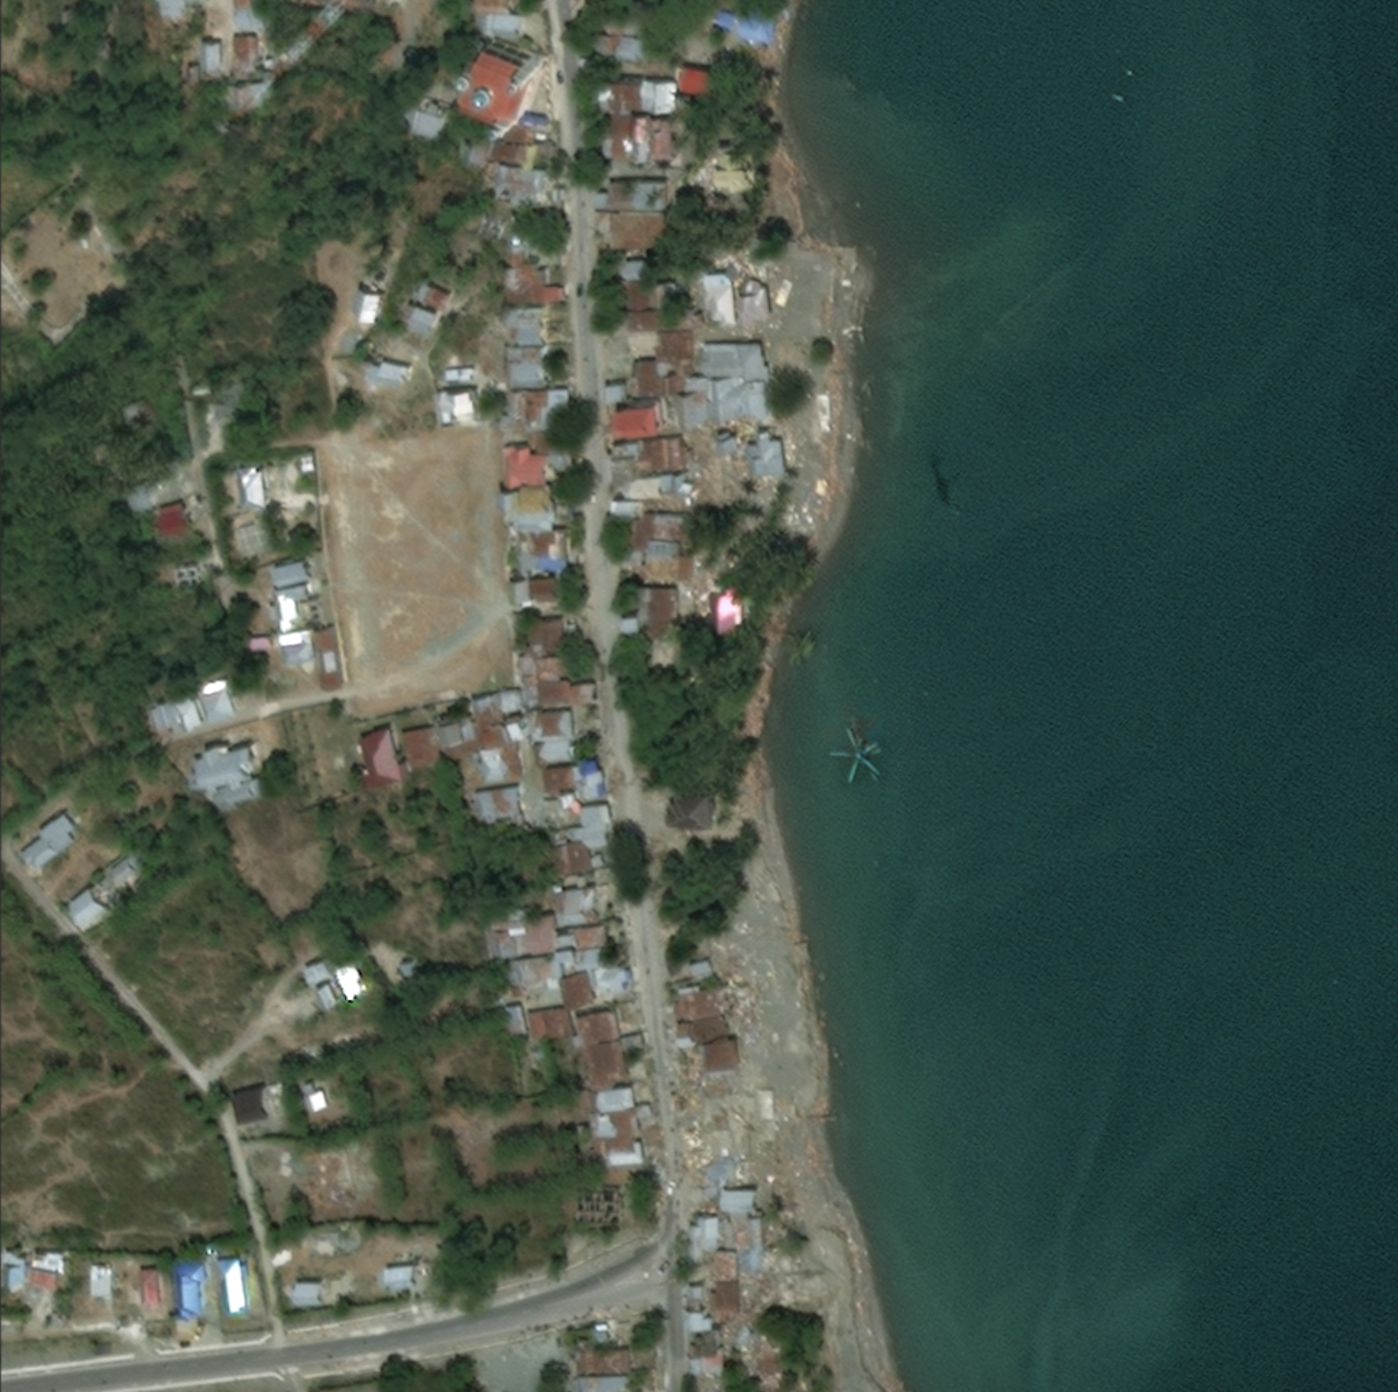
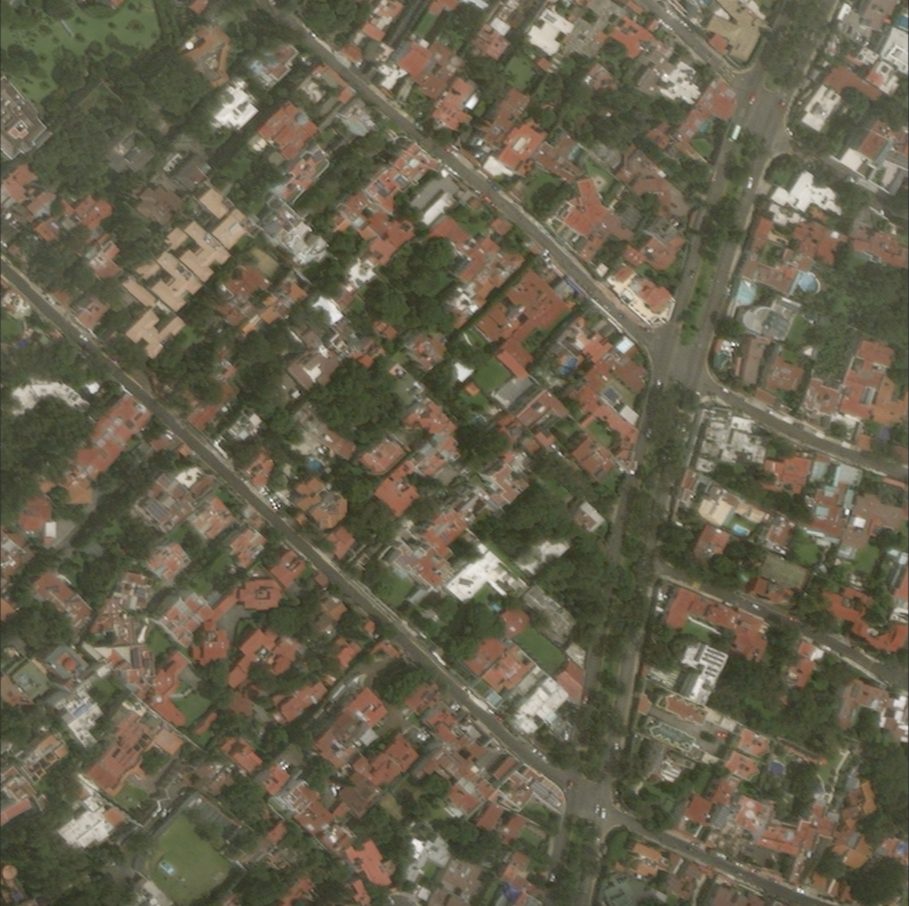
Satellite Imagery
Varying nature disaster Imagery
Santa rosa wildfire
Palu tsunami
Mexico earthquake

Slide 9
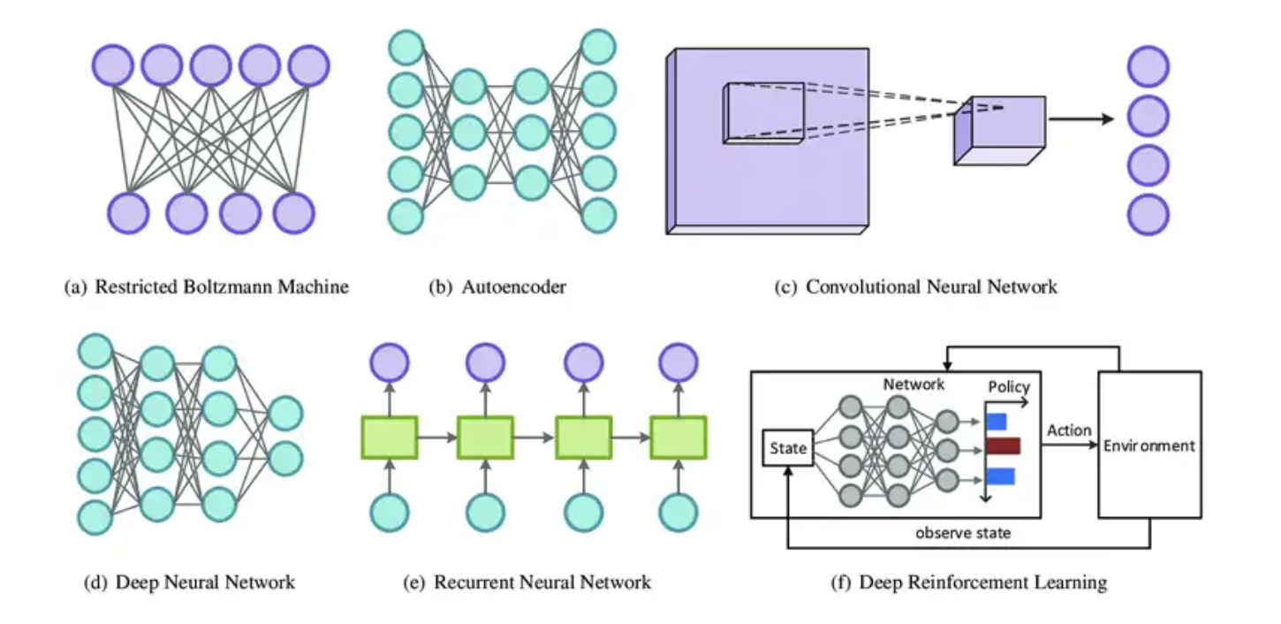
Deep Learning Model
Process large-scale satellite imagery and other data
Case: After the 2020 Beirut explosion in Lebanon, damage assessment models using satellite imagery and deep learning completed high-precision assessments of damaged buildings within hours, a process that would have taken days using traditional methods.

Slide 10
Deep Learning Model
Workflow
Satellite Imagery
Integrated Deep Learning Model
Automated segmentation and classification of building damage

Slide 11
Advantages
Real-time damage assessment
Improved emergency response
Wide coverage
Reduced costs and time
...
Real-time assessment of building damage following a disaster is essential for effective emergency response and resource allocation.

Slide 12
PART 02.
Current Solutions & Challenges
Why is this problem hard?
What is the obvious solution/baseline?

Slide 13
Current Solutions
Fully Convolutional Networks
(FCNs)
Convolutional Neural Networks (CNNs)
U-Net
Recurrent Neural Networks
(RNNs)
YOLO models

Slide 14
Current Solutions
CNN
“Building Damage Detection in Satellite Imagery Using Convolutional Neural Networks”
Used CNN models to detect damaged buildings after the 2010 Haiti earthquake
U-Net
“Post-disaster building damage assessment based on improved U-Net”
Achieved an F1 of 0.8741 for localization and F1 of 0.7536 for classification.
FCN
“Satellite Image Semantic Segmentation Using Fully Convolutional Network”
The overall accuracy reached 91.79%, and mean accuracy reached to 90.88%.

Slide 15
Current Solutions
RNN
“Identification of Building Damages using Satellite Images based on CNN- Recurrent Neural Network Approach”
Using a CNN-RNN methodology, obtained the accuracy of roughly 98%
YOLO
Improved YOLOv3 model, and obtained detection speed of up to 29.23 f/s, and target precision of 90.89%
“Detection of Collapsed Buildings in Post-Earthquake Remote Sensing Images Based on the Improved YOLOv3”

Slide 16
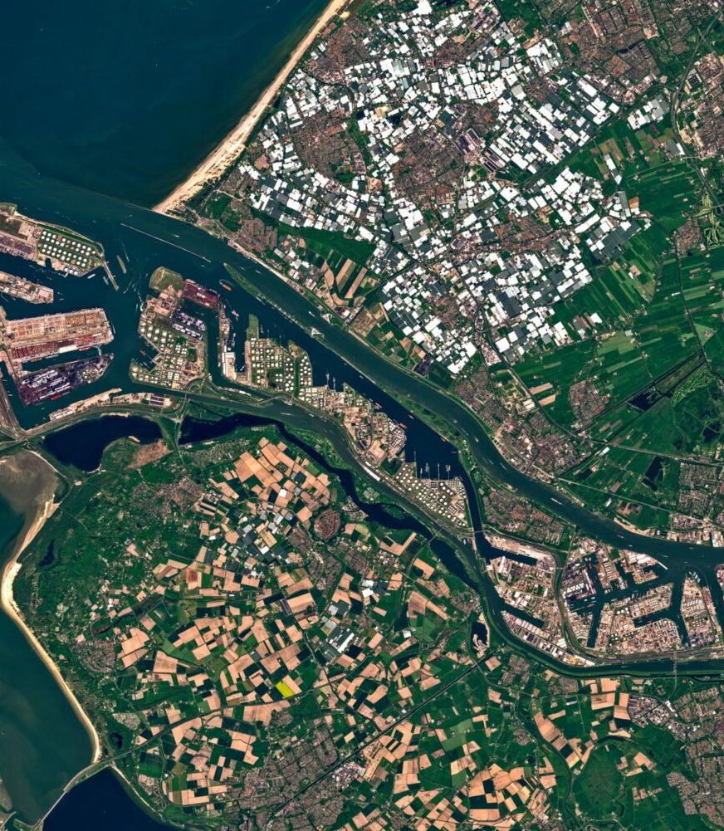
Challenges
Data Limitations
Cloud Obstruction
Variability in Disaster Impact
Integration of Multiple Data Sources

Slide 17
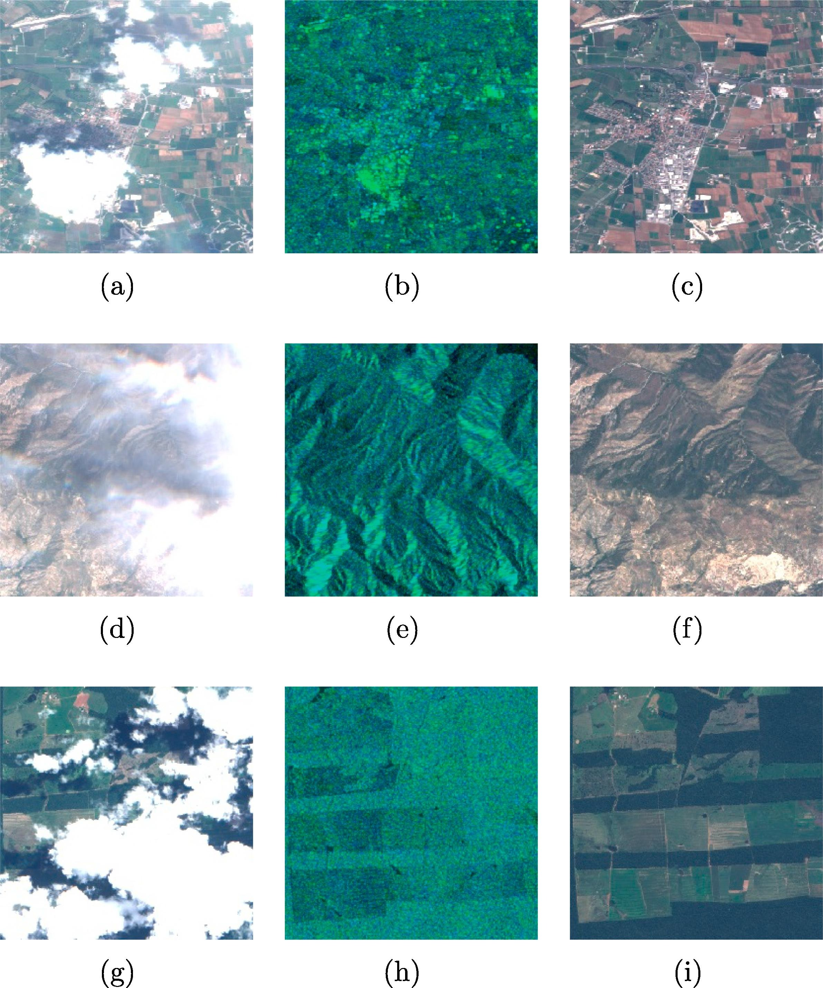
Challenges
Data Limitations
Cloud Obstruction
Variability in Disaster Impact
Integration of Multiple Data Sources

Slide 18
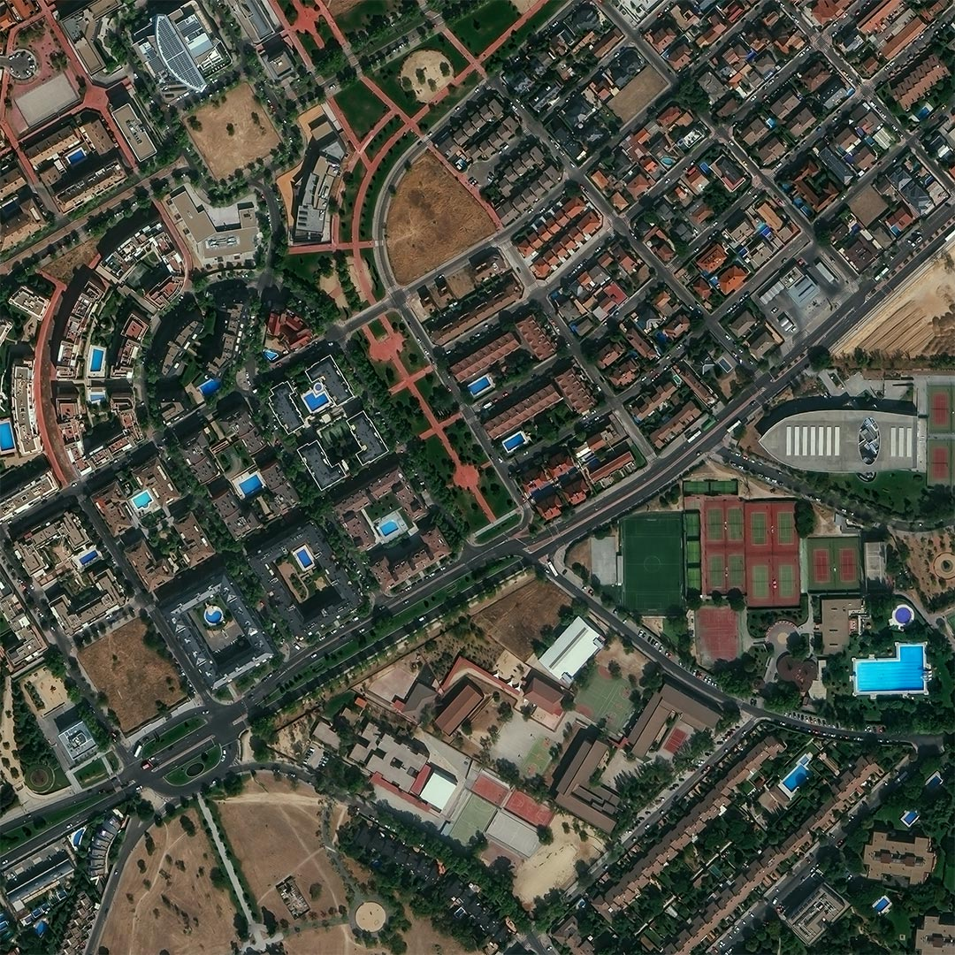
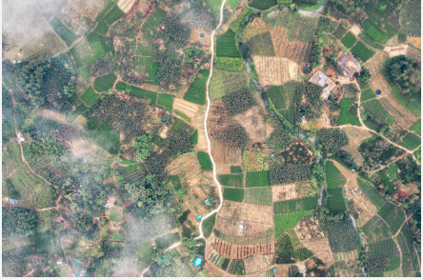
Challenges
Data Limitations
Cloud Obstruction
Variability in Disaster Impact
Integration of Multiple Data Sources
Urban vs. Rural

Slide 19
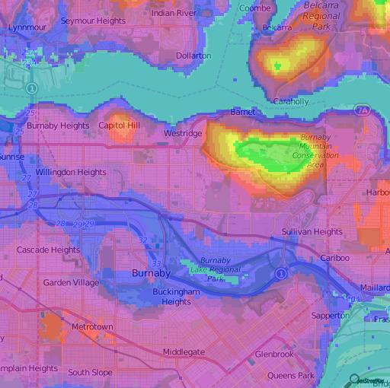
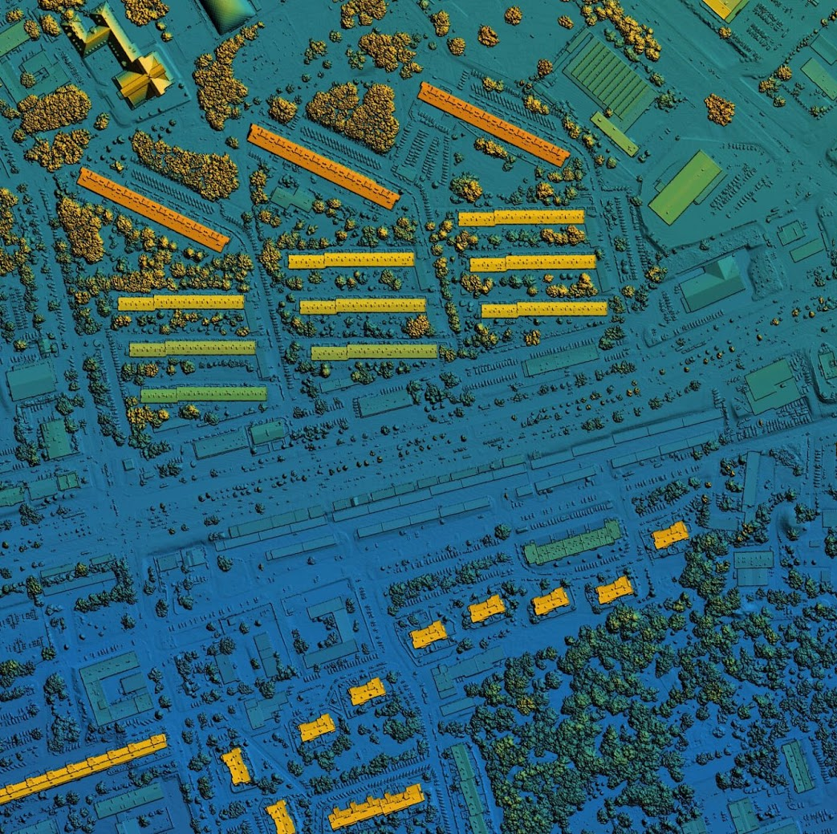
Challenges
Data Limitations
Cloud Obstruction
Variability in Disaster Impact
Integration of Multiple Data Sources
Elevation Map
LiDAR map

Slide 20
Proposed Solution & Milestones
PART 03.
What is the proposed solution and why is it better than the baseline?
Milestones

Slide 21
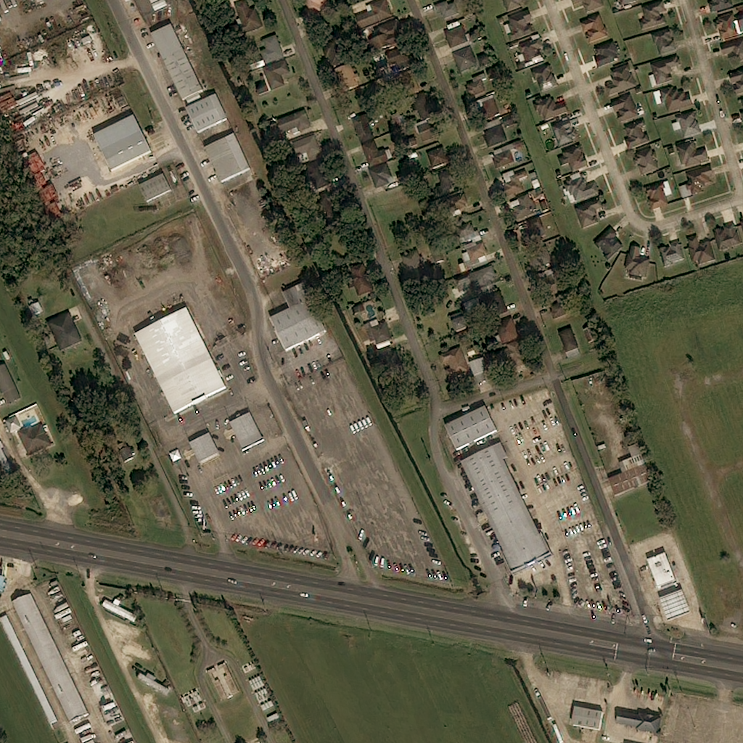
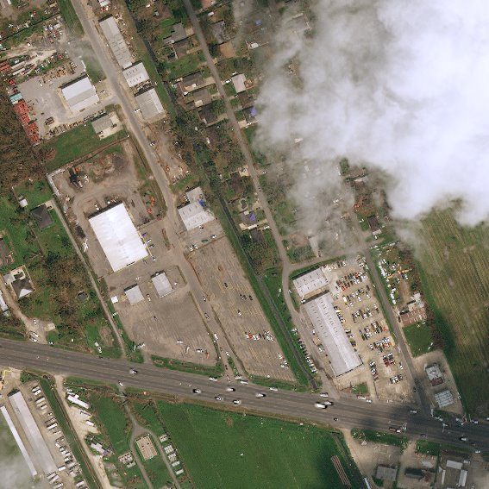
Proposed Solution
Limitation With Existing Works
Previous models struggle with satellite images that are obstructed by clouds, leading to inaccurate damage assessments.

Slide 22
Proposed Solution
Our approach involves assessing the performance of various models integrated with GAN to find the best solution for damage assessment.
Generative Adversarial Networks (GANs) will be used to generate realistic, cloud-free versions of post-disaster images.
GANs can help recover crucial visual information hidden by clouds, improving damage assessment.

Slide 23
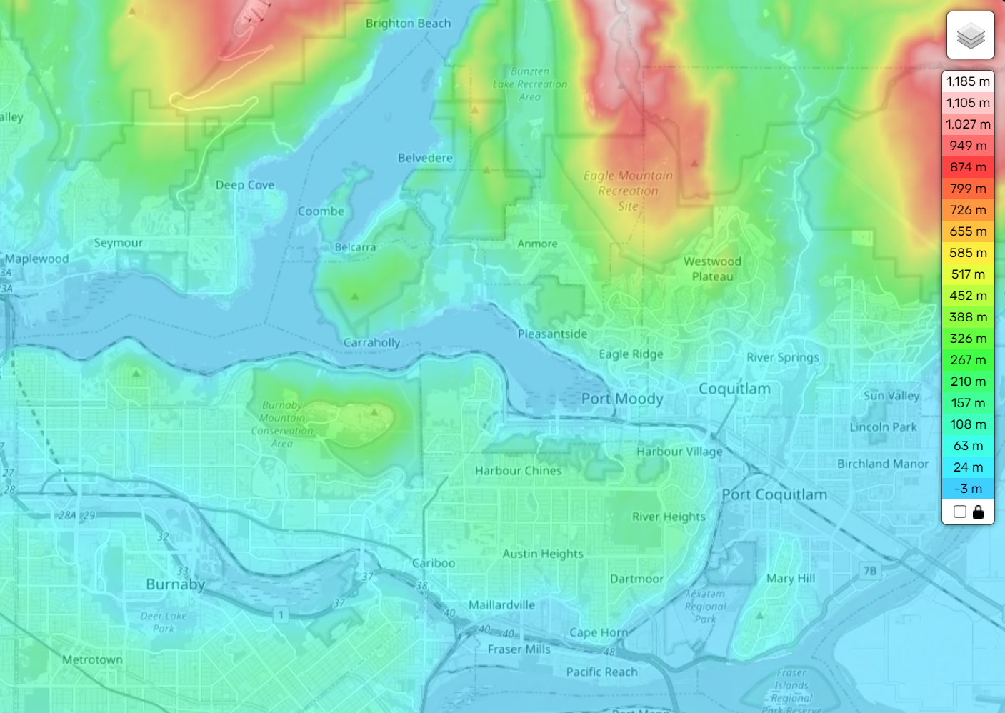
Proposed Solution
Meta Attributes:
The proposed solution would also utilize additional meta-attributes like elevation maps, land cover, or LiDAR data.
Enhances accuracy of the model's prediction

Slide 24
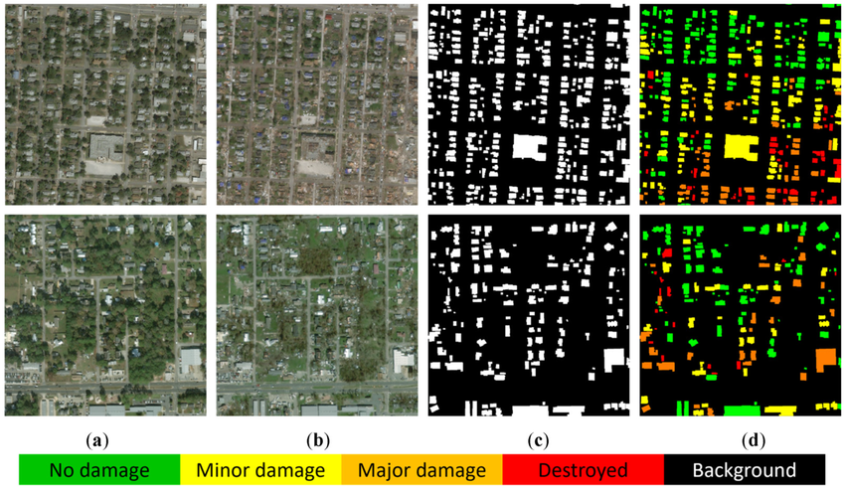
Proposed Solution: Datasets
xBD Dataset
Includes before and after satellite images of areas targeted by different natural disasters.
Labelled dataset ranging from no damage to completely destroyed.
Hurricane Ida Dataset
Satellite imagery captured before and after Hurricane Ida in 2021, focused on the areas near New Orleans, Louisiana
67 pairs of detailed imagery from one of the most heavily impacted regions.

Slide 25

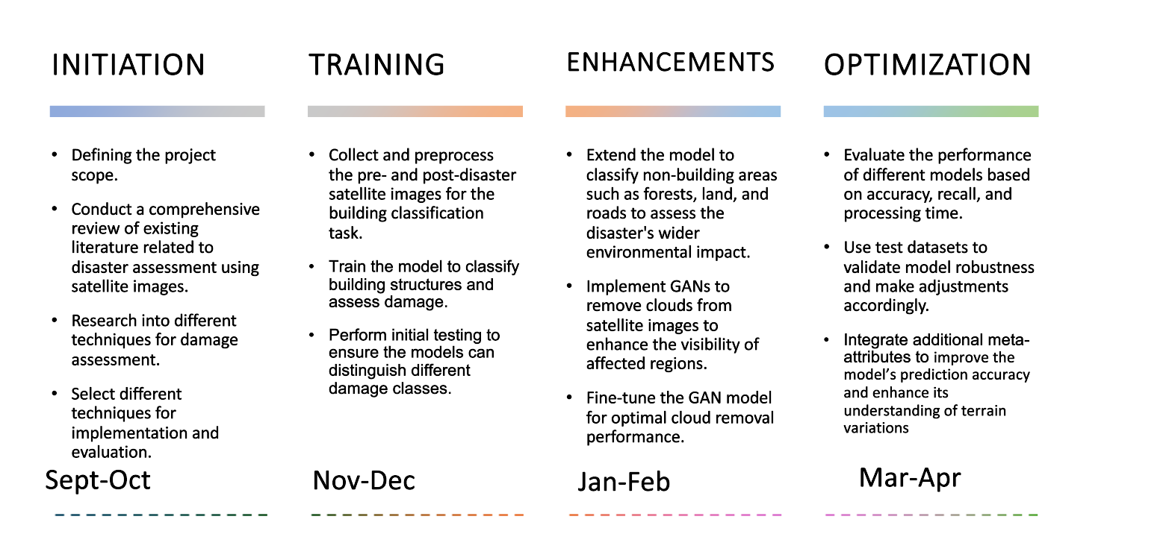
Project Milestones
At-a-glance
Initiation
TRAINING
Enhancements
optimization
Defining the project scope.
Conduct a comprehensive review of existing literature related to disaster assessment using satellite images.
Research into different techniques for damage assessment.
Select different techniques for implementation and evaluation.
Collect and preprocess the pre- and post-disaster satellite images for the building classification task.
Train the model to classify building structures and assess damage.
Perform initial testing to ensure the models can distinguish different damage classes.
Extend the model to classify non-building areas such as forests, land, and roads to assess the disaster's wider environmental impact.
Implement GANs to remove clouds from satellite images to enhance the visibility of affected regions.
Fine-tune the GAN model for optimal cloud removal performance.
Evaluate the performance of different models based on accuracy, recall, and processing time.
Use test datasets to validate model robustness and make adjustments accordingly.
Integrate additional meta-attributes to improve the model’s prediction accuracy and enhance its understanding of terrain variations
Sept-Oct
Nov-Dec
Jan-Feb
Mar-Apr

Slide 26
Conclusion
In this project, we want to identify efficient methods for assessing disaster damages based on satellite imagery combined with deep learning models.
This project aims to enhance some commonly-used models to address the problem of data limitations and cloud removement. Also, this project will integrate the current models with other meta-attributes to advance the damage assessment performance
The proposed approach is to implement and evaluate the performance of CNN, U-NET, FCN, RNN, YOLO integrated with GAN and meta-attributes (elevation map, land cover, or LiDAR data) trained on xBD and Hurricane Ida dataset.

Slide 27
References
Chavhan, G. K., Singh, S., Sahebrao Doke, A., Pilli, D., Kailasavalli, S., & Vyankatesh Ghamande, M. (2023). Identification of Building Damages using Satellite Images based on CNN- Recurrent Neural Network Approach. 2023 8th International Conference on Communication and Electronics Systems (ICCES), 1298–1303. https://doi.org/10.1109/ICCES57224.2023.10192592
Deng, L., & Wang, Y. (2022). Post-disaster building damage assessment based on improved U-Net. Scientific Reports, 12(1), 15862. https://doi.org/10.1038/s41598-022-20114-w
Ma, H., Liu, Y., Ren, Y., & Yu, J. (2019). Detection of Collapsed Buildings in Post-Earthquake Remote Sensing Images Based on the Improved YOLOv3. Remote Sensing, 12(1), 44. https://doi.org/10.3390/rs12010044
Takiguchi, T., Fujieda, S., & Hosoi, A. (2018). Satellite image semantic segmentation using fully convolutional network. 2018 IEEE Conference on Computer Vision and Pattern Recognition Workshops (CVPRW), 5(2), 10-14. https://doi.org/10.1109/CVPRW.2018.10
Xu, J. Z., Lu, W., Li, Z., Khaitan, P., & Zaytseva, V. (2019). Building Damage Detection in Satellite Imagery Using Convolutional Neural Networks (No. arXiv:1910.06444). arXiv. http://arxiv.org/abs/1910.06444

